Slide 1
Robust Generalizations
이관희
졸업프로젝트 1

Slide 2
Contents
Adversarial Robustness via Adaptive Label Smoothing, ICLR 22’
Rethinking Softmax Cross-Entropy Loss for Adversarial Robustness, ICLR 20’
Improved OOD Generalization via Adversarial Training and Pretraining, ICML 21’
Positive-Negative Momentum : Manipulating Stochastic Gradient Noise to Improve Generalization, ICML 21’
Wrap-up, Open Questions.

Slide 3
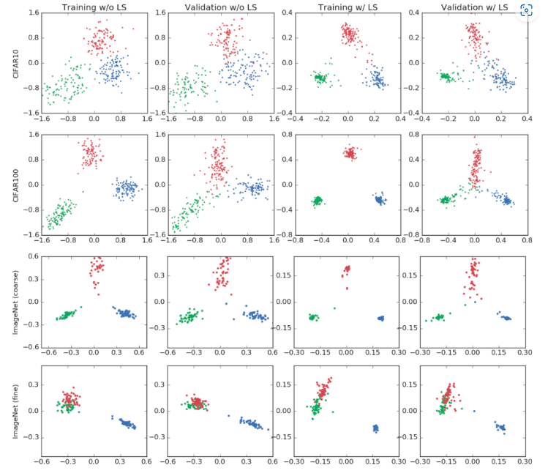

Adversarial Robustness via Adaptive Label Smoothing goibert et al., ICLR 22’
Abstract
Label smoothing -> improves robustness
Label smoothing (Szegedy et al., 2016)
=> $y_{k}^{LS}=y_{k}\left(1−α\right)+\frac{α}{K}$
Improves generalization
Apply label smoothing in AT?

Slide 4
Adversarial Robustness via Adaptive Label Smoothing goibert et al., ICLR 22’
Intro
Prior works : using LS in AT naively doesn’t work well
LS can smooth local gradients of adversarial perturbation
Solution : input-adaptive Label Smoothing
Calculates the distance of input from decision boundary, and apply label smoothing w.r.t the distance
Effect:
->tighter cluster bounds for each class, more robustness

Slide 5
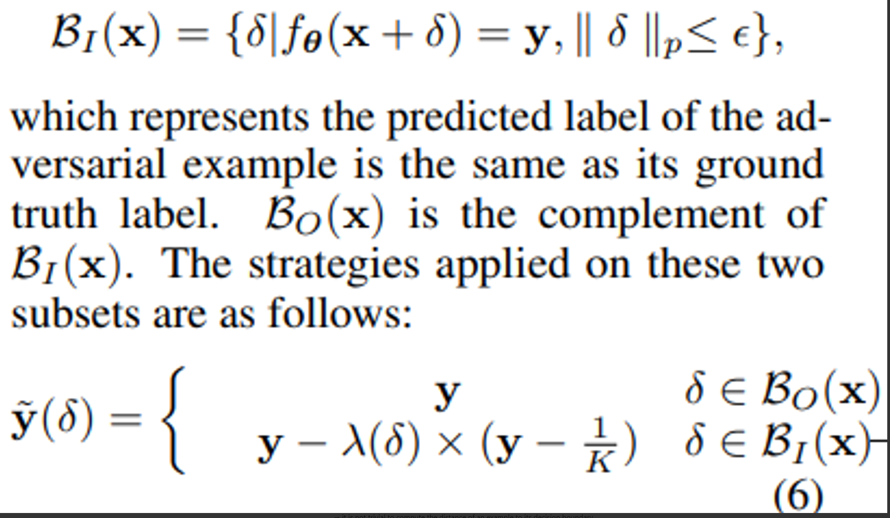
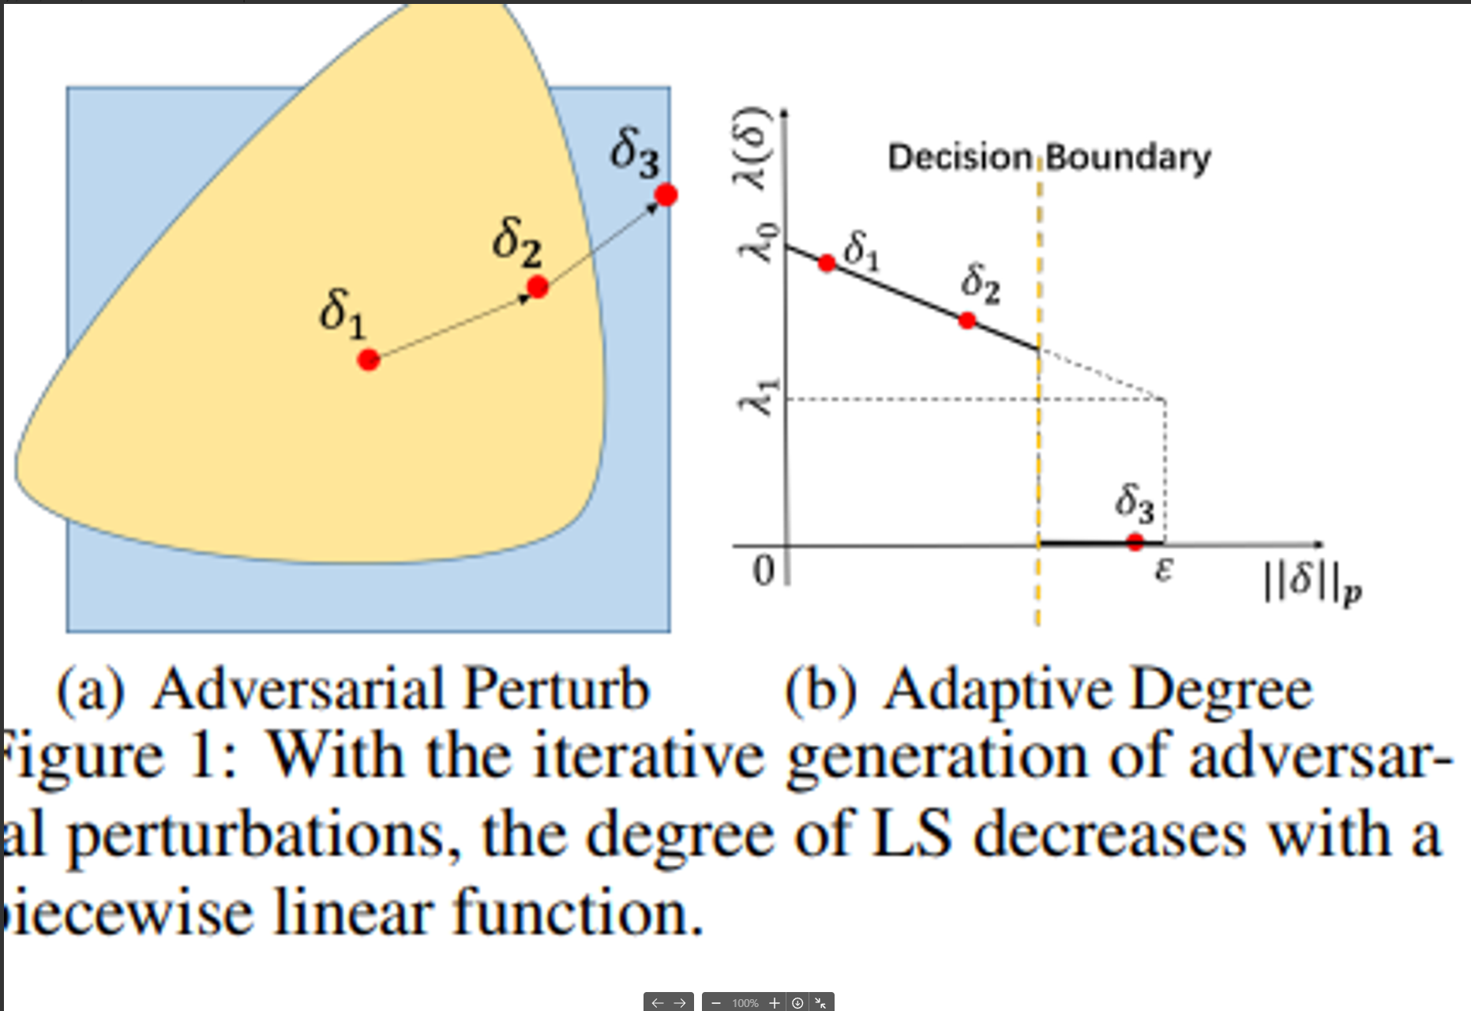

Adversarial Robustness via Adaptive Label Smoothing goibert et al., ICLR 22’
Objective Function
$$\min_{θ}E_{\left(x,y\right)}L\left(f_{θ}\left(x+δ^{∗}\right),\tilde{y}\left(δ^{∗}\right)\right)$$
$$δ^{∗}=\arg{\max_{{\left|\left|δ\right|\right|}_{p}≤ε}{L(f_{θ}(x+δ,y)}}$$
=> Applies smooth label w.r.t. perturbation strength, and miss-classification

Slide 6
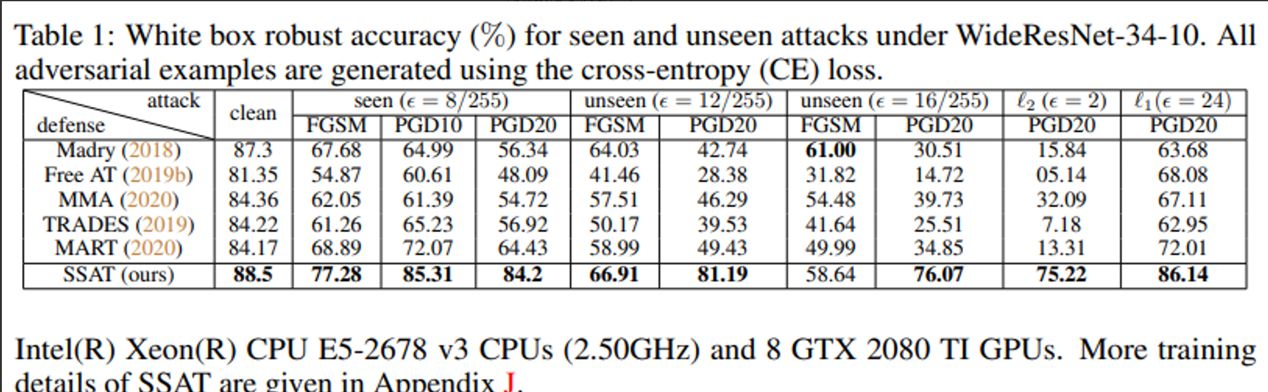
Adversarial Robustness via Adaptive Label Smoothing goibert et al., ICLR 22’
Results
** label smoothing ~= multi-class classification with different labels (1,-1…)

Slide 7
Rethinking Softmax Cross-Entropy Loss for Adversarial Robustness Pang et al., ICLR 20’
Abstract
Adversarially robust generalization => requires larger sample complexity (more data)
e.g) unlabeled data, generative models..
* SCE Loss => features are scatters sparsely in feature space, reducing robustness of model.
* Rather, design novel loss to make samples gather up in feature space
=> MMC Loss

Slide 8
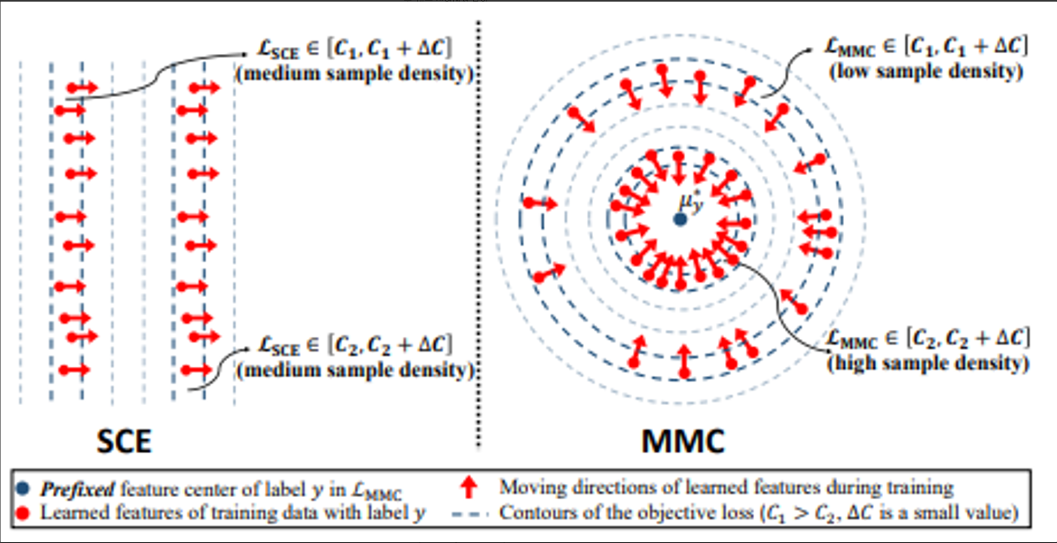
Rethinking Softmax Cross-Entropy Loss for Adversarial Robustness Pang et al., ICLR 20’
Intro
SCE – Softmax Cross-Entropy : SOTA, but likely to be fooled by adv samples
Why? => SCE scatters features in feature space
Existing Solution
Use AT to gain more robustness
AT has tradeoff (clean acc) , computational burden
contrastive,triplet,center loss -> to make feature distribution closer to each other, but has limitations.
In this paper => MMC Loss, and formally prove that SCE has sparsely scattered features due to softmax function

Slide 9
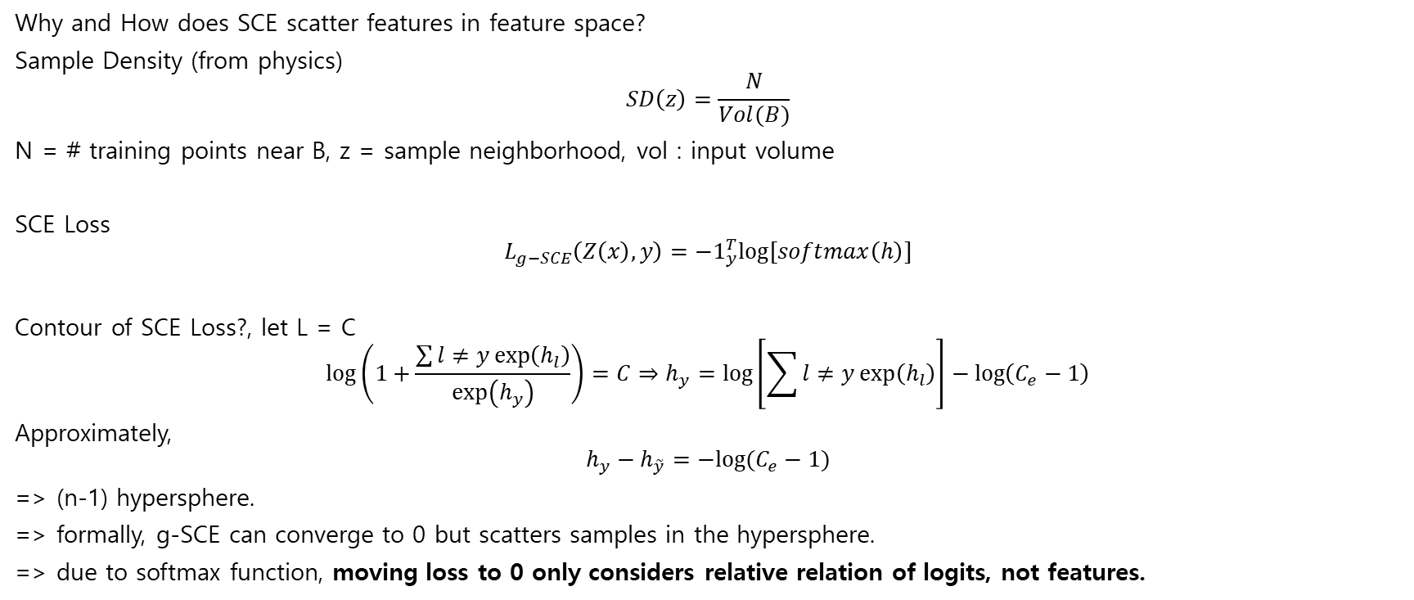
Rethinking Softmax Cross-Entropy Loss for Adversarial Robustness Pang et al., ICLR 20’
Why and How does SCE scatter features in feature space?
Sample Density (from physics)
$$SD\left(z\right)=\frac{N}{Vol(B)}$$
N = # training points near B, z = sample neighborhood, vol : input volume
SCE Loss
$$L_{g−SCE}\left(Z\left(x\right),y\right)=−1_{y}^{T}log⁡[softmax\left(h\right)]$$
Contour of SCE Loss?, let L = C
$$\log\left(1+\frac{\sum{l≠y\exp\left(h_{l}\right)}}{\exp\left(h_{y}\right)}\right)=C⇒h_{y}=\log\left[\sum{l≠y\exp\left(h_{l}\right)}\right]−\log\left(C_{e}−1\right)$$
Approximately,
$$h_{y}−h_{\tilde{y}}=−log⁡(C_{e}−1)$$
=> (n-1) hypersphere.
=> formally, g-SCE can converge to 0 but scatters samples in the hypersphere.
=> due to softmax function, moving loss to 0 only considers relative relation of logits, not features.

Slide 10
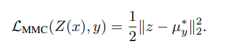
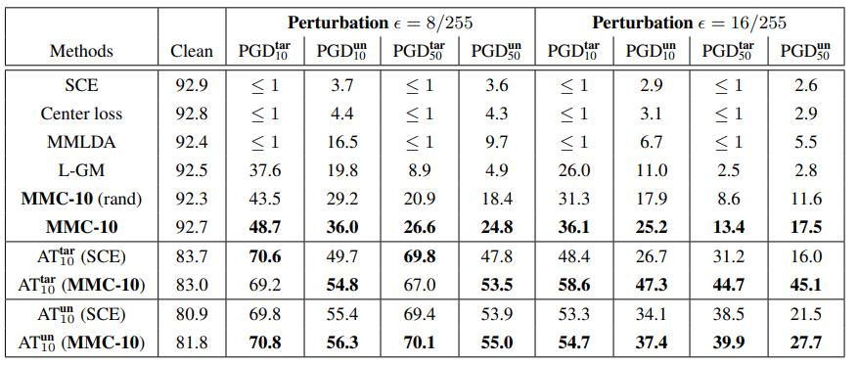
Rethinking Softmax Cross-Entropy Loss for Adversarial Robustness Pang et al., ICLR 20’
MMc loss?
Move features closely to preset center, clustering features into tighter clusters
Moving loss to 0 = higher sample density..
Results on white-box attack (PGD), CIFAR-10

Slide 11
Improved OOD Generalization via Adversarial Training and Pretraining Yi et al., ICML 21’
Robust models generalize well on OOD.
Why?
Robust models gained from AT = perturbation training => distribution shift => distributional robustness
Analysis on convergence rate of multi-step SGD based AT and finds excess risk of OOD data

Slide 12
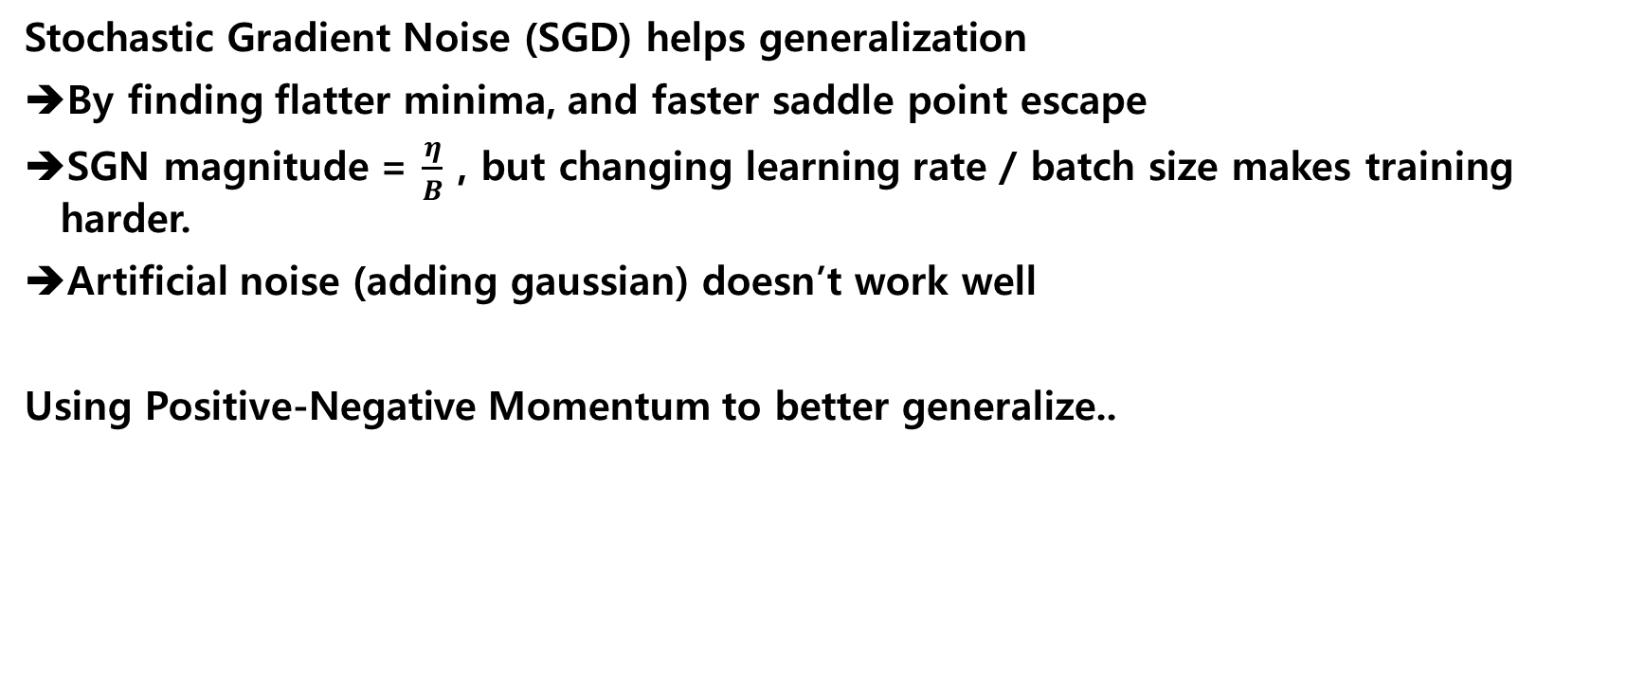
Positive-Negative Momentum : Manipulating Stochastic Gradient Noise to Improve Generalization, Xie et al., ICML 21’
Stochastic Gradient Noise (SGD) helps generalization
By finding flatter minima, and faster saddle point escape
SGN magnitude = $\frac{η}{B}$ , but changing learning rate / batch size makes training harder.
Artificial noise (adding gaussian) doesn’t work well
Using Positive-Negative Momentum to better generalize..

Slide 13
Open Questions
1 -> using label smoothing to help better generalization
2 -> softmax does not consider feature space
3 -> AT = distributional robustness
4 -> SGN helps generalization
Some Experiments using LS on AT
Overfitting occurs..
Ideas?

